Slide 1
CitySlip
TEAM 1
MIRIAM / NATHAN / KRIS

Slide 2
CitySlip: Overview
CitySlip is designed to receive a single U.S. zip code and provide feedback to the user on 6 categories:
Population and Age Demographics
Points of Interest (i.e. parks, theatres, stores)
Housing Market
Schools
Crime Risk
General Weather

Slide 3
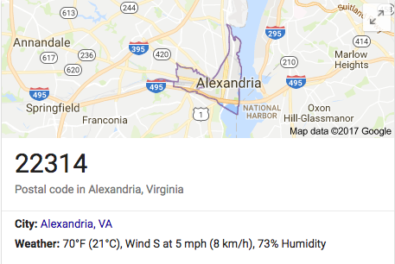
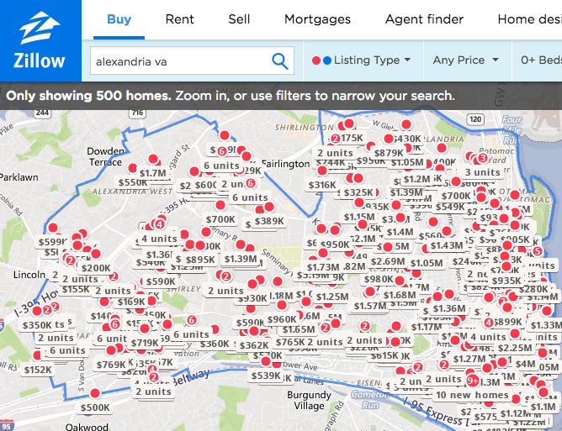
CitySlip: Purpose
CitySlip’s categories and associated data sets were sought after in effort to provide a user with a foundational point when contemplating a potential move to a U.S. city
A simple Google search only provides very basic information on the city or zip code of choice
Navigating Zillow for information on average rent or real estate listings can be time consuming

Slide 4
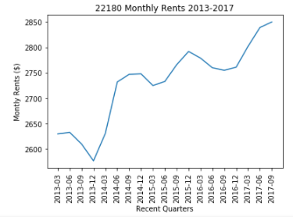
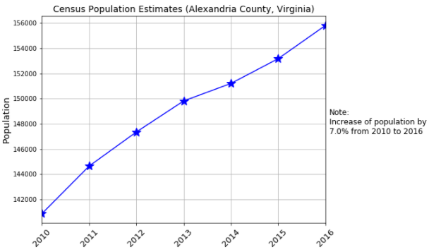
CitySlip: Value
CitySlip provides a user with a sense of the area in question…
What is the population and its growth rate?
Are there places to shop and things to do?
How affordable is the market to rent or buy?
What is the average age of residents?
How many and what type of schools are in the area?
Would this be a good place to live?

Slide 5
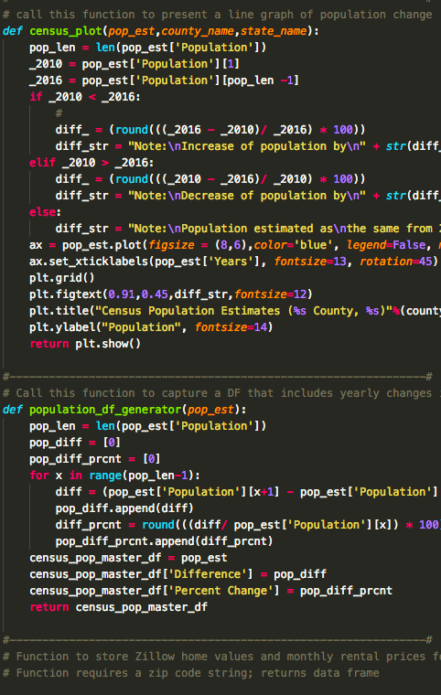
CitySlip: Data
CitySlip accesses various APIs and static datasets:
Google Maps API:
8km (~5 mile) radius search for: Movie Theatres,
Grocery/Supermarkets, Shopping Malls,
Parks, Gyms, and Liquor Stores
Onboard API:
Schools in the area
Age demographics
Crime risk, Sales tax, Average Temperature
Walkscore API
Score of walkability
Census Block Conversions API
Converts Lat/Lon to county/state

Slide 6
CitySlip: Data cont.
Zillow CSV files:
Market Health Index:
Home Value 2014 – 2017: Average home value
Rent Value 2014 – 2017: Average rent
Census American Community Survey (ACS):
2010 – 2016: Provides 116 columns of data on 3,193 counties
U.S. Zip Codes:
Data was cleaned with the removal of ‘Unique’, ‘Military’, and ‘PO Box’ zip codes

Slide 7
CitySlip: Scoring the Results
10 variables are defined to produce a total score from 0 to 100
Variable | Weight | Basis
Points of Interest Count | .30 | High Count
Crime Risk | .15 | Low Risk
Winter/Summer Temperature | .10 | Moderate
School Count | .10 | High Count
Population Growth | .10 | Moderate Growth
Home Value | .05 | Compared to National Average
Monthly Rent | .05 | Compared to National Average
Real Estate Market Health | .05 | Strong Market
Sales Tax | .05 | Low Tax Rate
Walkability | .05 | Pedestrian Friendly

Slide 8
CitySlip: Conclusion
Accesses 5 data resources targeting a single Zip Code
Plots 6 graphs:
Pie Charts: Places of Interest | Age Demographics
Line Graphs: Population Growth | Average Rent | Average Home Value
Bar Chart: School Type Count
Provides a general sense of area
How many schools in the area?
What are the population demographics?
Is it affordable to rent or buy?
Etc.
Presents a subjective score for that Zip Code
Outputs a CSV with all past Zip Codes that have been run

